Slide 1


Liverpool Canoe Club
AGM
13/10/2014
Please sign the attendance register

Slide 2
Treasurer Report _{Sam Godsell}
All the club accounts are on the website – every transactions is itemised.
Online club accounts………
Turnover £30,000
Balance carried forward Sept 2013 - £7351
Balance carried forward Sept 2014 - £6738
Membership income was £4,478
Largest expenditure was Equipment at £8315
Jackson Duo, Open Boat, Riot playboat, Delphin Sea Kayak, new paddles, Spraydecks, 2nd Burn, 15 x 2nd hand polo boats from Manchester CC, Notice boards, Buoyancy blocks and airbags etc

Slide 3
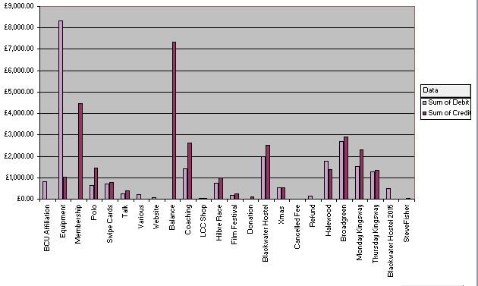
Club Accounts 2013-2014

Slide 4
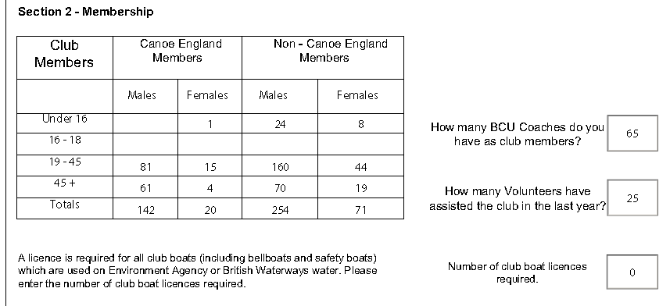
Membership Secretary & Volunteers – Keith Steer
2012 288 Members – Affiliation fees £575.80
2013 424 Members – Affiliation fees £784.20
2014 487 Members – Affiliation fees £818.00
Current Total 464 Current Full Members

Slide 5
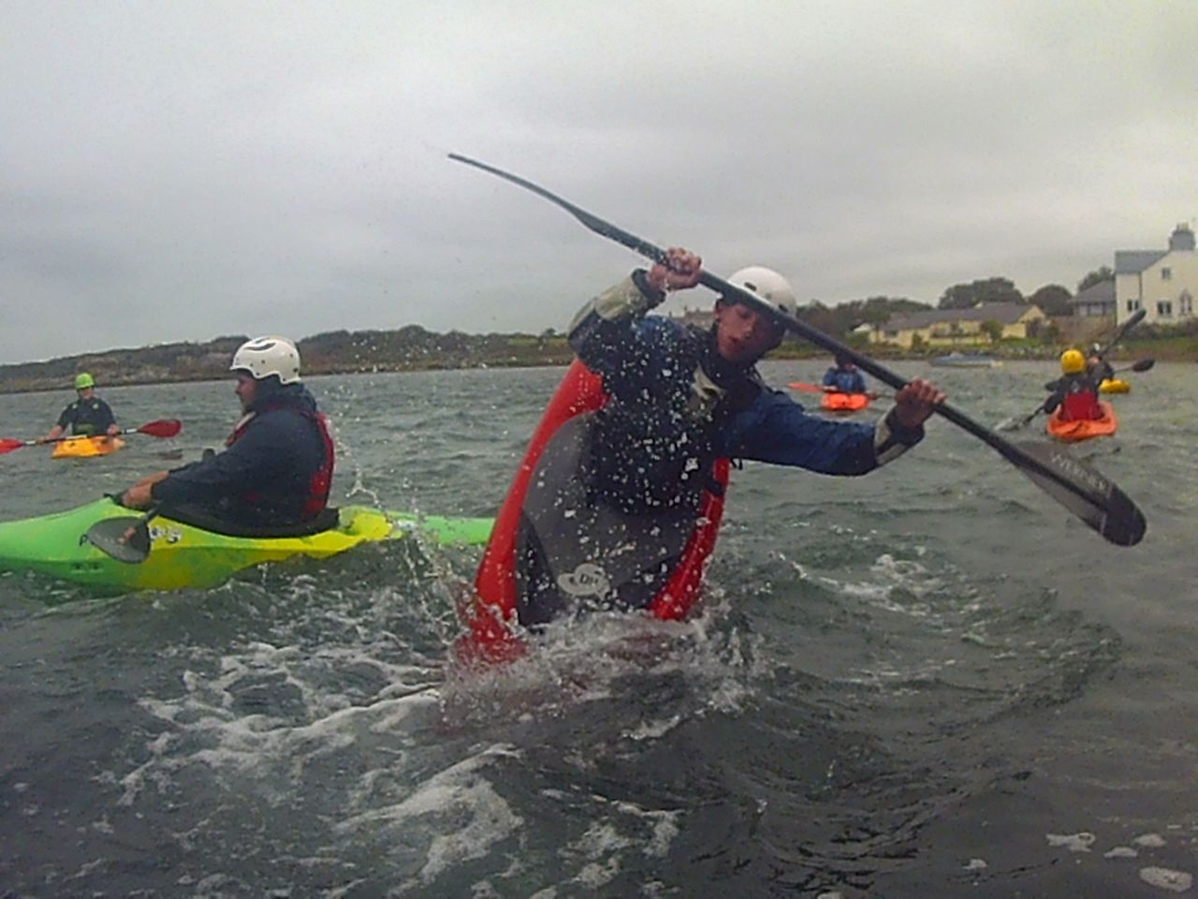
Discipline Reports – Freestyle _{Mark Garrod}
Purchase of a lot more freestyle
boats by club members.
-Any Aspirant Freestyle Paddlers
-Sam Preston
-Tees Barrage Club Trip
-Don't Let a Swim stop You
-Surfing Trips - Anglesey, Crosby.
-Play Boating on the French Alps
-You can’t take the Liverpool out of the Freestyle Paddler but you can take the Freestyle Paddler out of Liverpool.

Slide 6
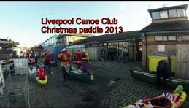
Discipline Reports – Social

Slide 7
Discipline Reports – Social
The number of junior members has increased this year and social events we have arranged like Halloween, Christmas and Easter paddles have had really good turn outs. Easter was once again back in the docks after last year being held in the pool. It saw lots of paddlers on the water along with copious amounts of cake, chocolate and hot juice.
Last years Santa dash to Dukes Dock was a very festive affair! Inflatable Santa's, tinsel and fairy lights were in abundance. Over 35 members attended and enjoyed hot Vimto, warm mulled wine and mince pies whilst sheltering on the slipway opposite the wheel. We will be definitely planning a Santa dash nearer Christmas.

Slide 8
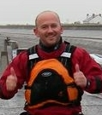
Discipline Reports – Sea _{Brian Green}
Introduction to Sea Kayaking Course run at the docks – Peter Thomas
Menorca Expedition
Purchase of 3 new sea kayaks for the club
Georgian Bay Expedition to Canada

Slide 9
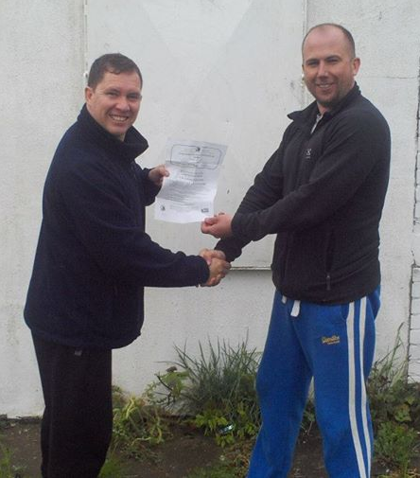
Discipline Reports – Slalom _{Darren Bohanna}
_{and Michal Giezgala}
Sven, Will McCormack and I headed off to Oughtibridge near Sheffield for our first slalom comp, Div 4 & 3 in May.
I got promoted to div 3.
We used the green plastic Fox
club slalom boats.

Slide 10
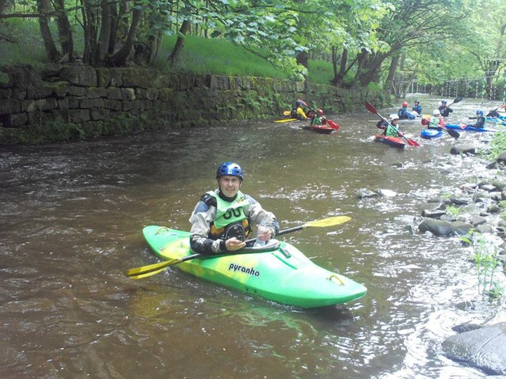
Competition in Wagon Lane, Bradford and Bingley Canoe Club: DIV4

Slide 11
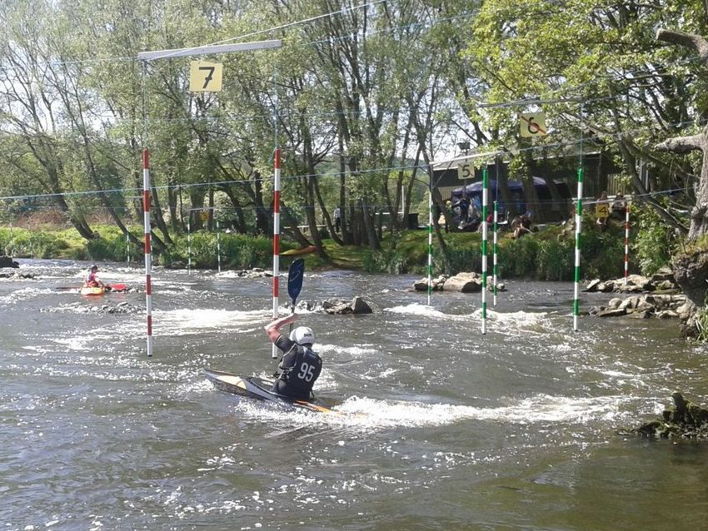
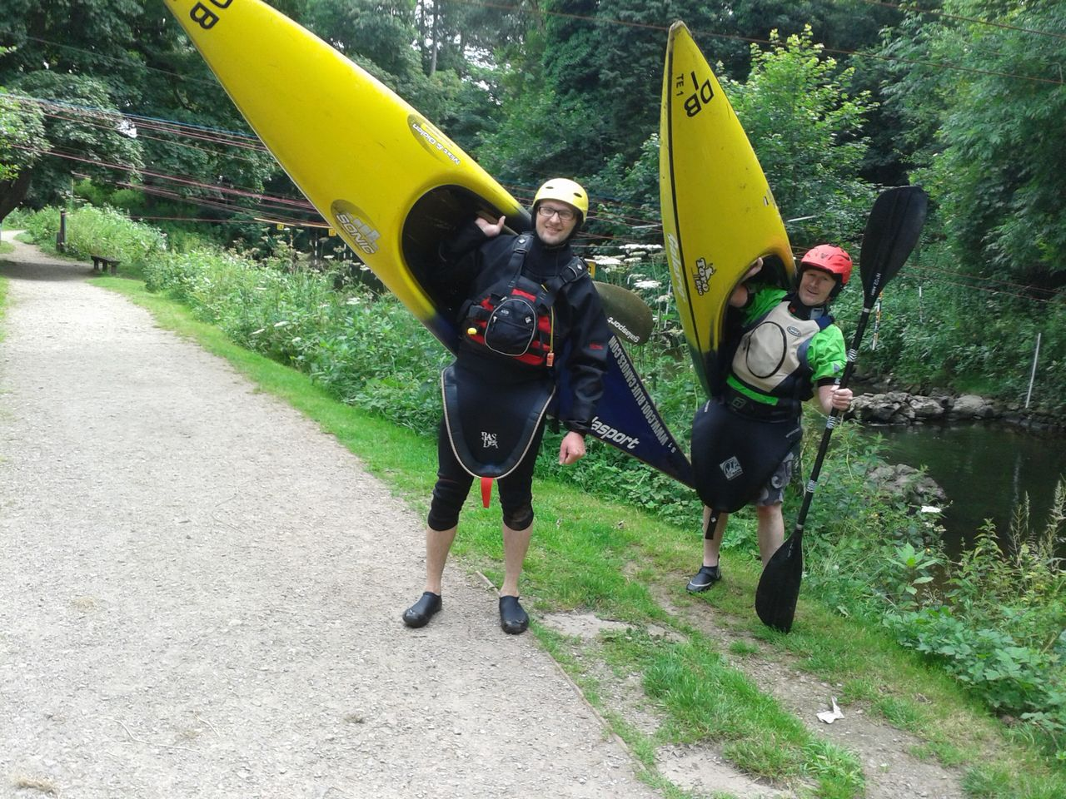
Stafford and Stone Canoe Club: coaching session & DIV3

Slide 12
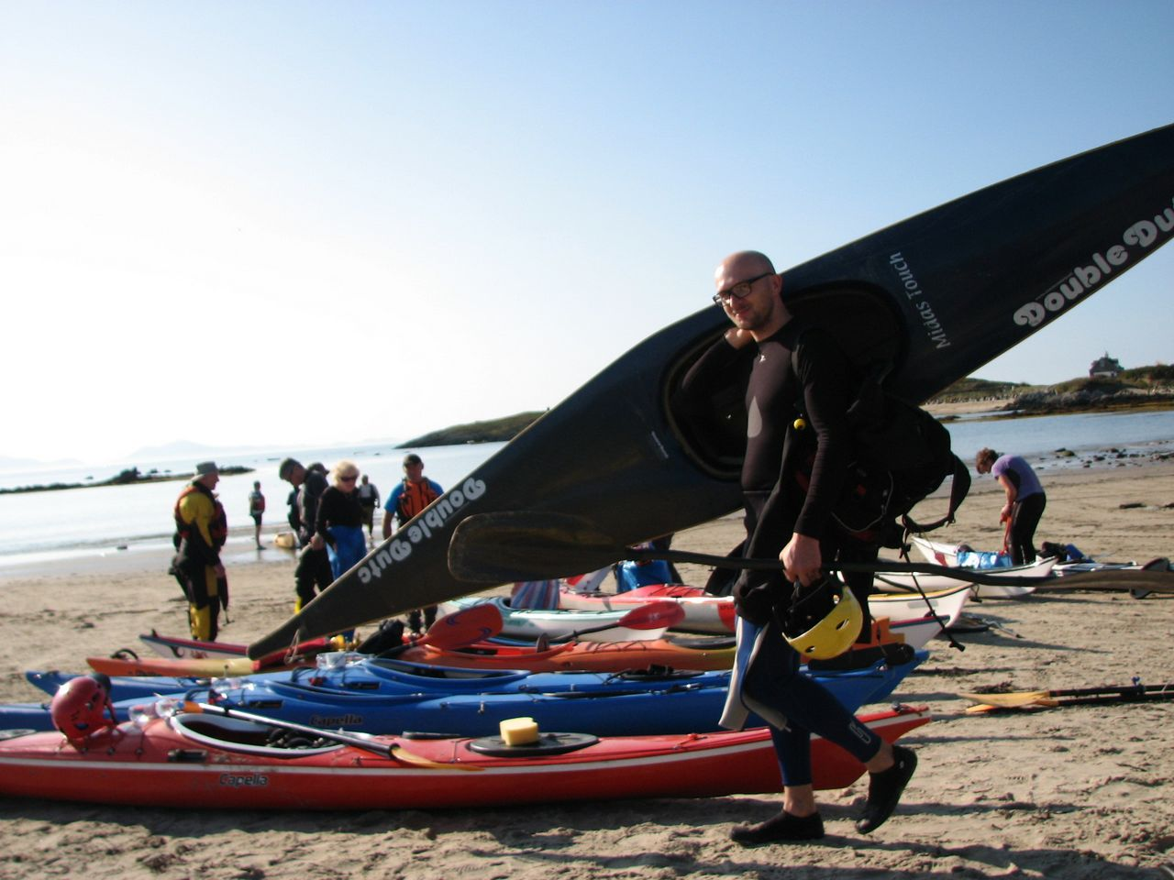
Anglesey Weekend: Slalom in the bay

Slide 13
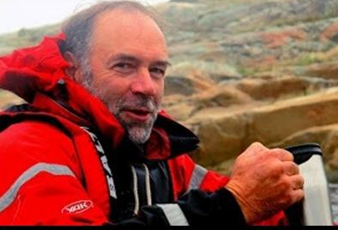
Discipline Reports – Coaching _{Ian} _{Bell}
Coach Mentor Scheme
Rosie Diver Coaching (Open boats and Ladies group)
Introductory Courses at the docks
Kingsway Pool
Dave Reynolds Rolling courses at Broadgreen pool
Improver White Water Coaching courses run by Mark Young and Roy McHale
Pete Thomas Introduction to Sea Kayaking
1, 2 and 3 Star training and assessment courses

Slide 14
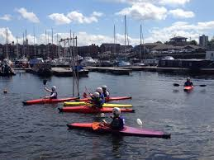
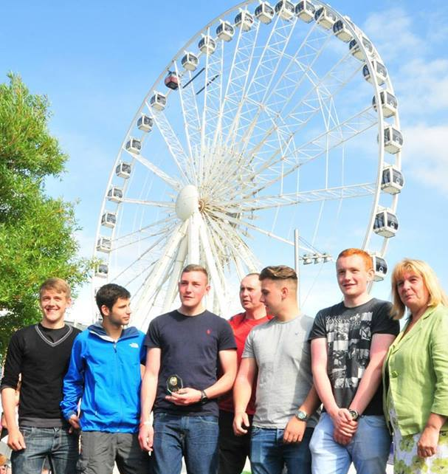
Discipline Reports – Polo _{Scott Gibson}
The national leagues
Local leagues
Ladies teams
Liverpool international
Pool sessions
Looking to start a under 18 team
next year.

Slide 15
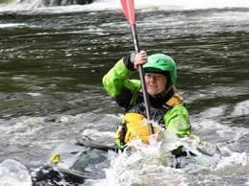
Discipline Reports – White Water
_{Roy McHale} _{& Mark Young}
Improvers Trips developing leaders and assistants
2 x 3 Star White Water Assessments run on the river Dee
Several White Water Safety and rescue Courses organised with outside providers
Alps trip
4 star training and assessments

Slide 16
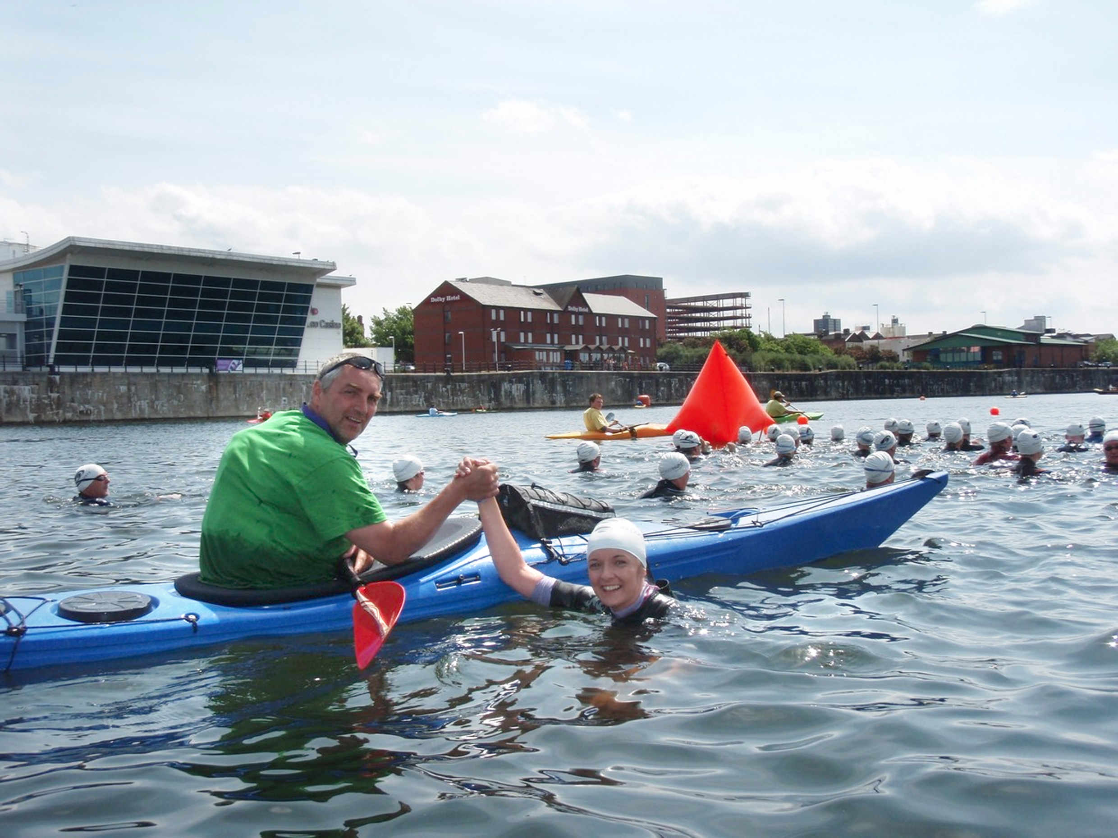
Discipline Reports – Kayak Safety _{John Worswick}

Slide 17
Discipline Reports – Juniors _{Chris Murphy}
Tuesday night Junior club at the docks (summer)
Tuesday night at Broadgreen (winter)
Saturday morning Junior club and Youth Development
Pen y Bont Junior club camp
Juniors in the Alps.
Peel Island bivvi
Hilbre island (The Masseys!)
John Allerton’s junior paddles at the Dee and Burrs etc
The Tatum’s and the Harwood’s surf sessions? (I believe they take their kids on occasion?)

Slide 18
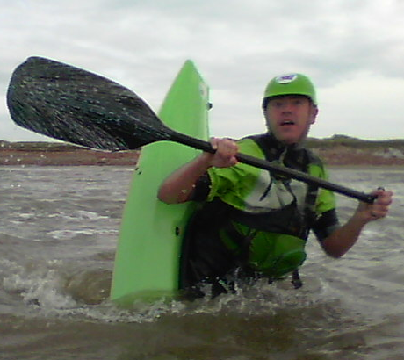
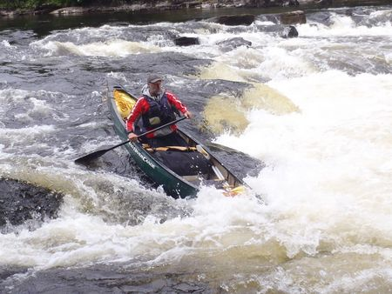
Discipline Reports – Open Canoeing _{Paul Harwood}
Canoeing in the club has gone from strength to strength this year due to the trips that Mike Alter has put on and the Canoe courses held at the docks by Rosie Diver.
“Single blading” is the only style of paddling I do, but
I hope that Mike Alter and Ruth Edwards can take it over and take canoeing places I cannot.
You will mainly see me at the beach or the docks but always in a canoe of some description.

